Slide 1
Communication & Health Education

Slide 2
Outlines and objectives
At the end of the lecture, you will be able to recognize concepts related to the following areas:
Definition of communication
Importance of communication
Components of communication
Models of communication
Process of interpersonal; communication
Theories of communication

Slide 3
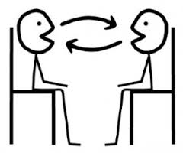
Communication
A dynamic, two ways circular process in which all types of information are shared between two or more people and their environment.

Slide 4
Definition of communication
Communication, the process of transmitting thoughts, feelings, facts, and other information, includes verbal and nonverbal behavior.
Stuart & Laraia (1998) describe communication as every aspect of behavior and, therefore, more than simply transmitting or imparting facts.

Slide 5
Importance off communication
Communication fulfils several functions that are important for our well-being and survival.
It helps us establish relationships, share information and
ideas, and give meanings to everything we do.
In the health care professions, communication assumes major significance in demonstrating a caring and a therapeutic approach.

Slide 6
Importance off communication
Failure to give accurate and easily understood information, for example, can lead to anxiety and may have serious consequences where sensitive treatment are concerned.
Miscommunication can lead to conflict and misunderstandings, and
most importantly, can jeopardize patient safety.

Slide 7
In nursing,
Communication is important to nursing practice since all nursing care involves some degree of communication.

Slide 8
Purpose of communication
We need communication to understand & be understood.

Slide 9
Components of communication
  The stimulus : Reason for communication
  The sender : The individual who initiate the transmission of information.
  The message : The information, feelings, thought and ideas being sent and received.
  The medium : The method by which the message is sent).
  The receiver : The individual who both receives and interprets the message.
  The feed back: The measure by which the effectiveness of the message is gauged (evaluated).

Slide 10
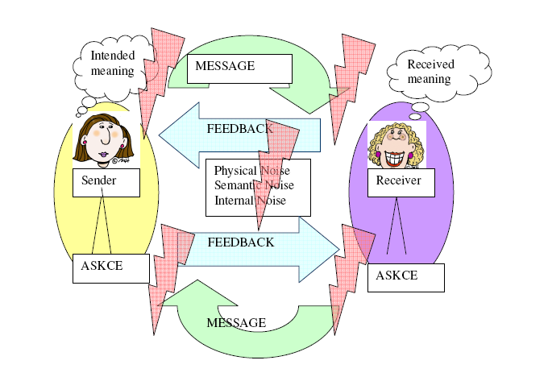
Components of the Communication Process

Slide 11
1. The Sender
The communication process begins when a person, known as the sender, generates a message.
Messages stem from a person’s need to relate to others, to create meanings, and to understand various situations.
Messages are generated by external factors, such as what the sender sees, hears, touches, tastes, or smells.

Slide 12
However, the sender also perceives internal stimuli that generate messages.
Examples of internal stimuli that affect communication include hunger, fatigue, or the mental activities of thinking and fantasizing (i.e., self-talk).
The source (or encoder) is the stimulus, such as the idea, event, or situation.
Encoding involves the use of language and other specific signs and symbols for sending messages.

Slide 13
2. The Message
The message is a stimulus produced by a sender and responded to by a receiver.
Messages may be verbal, nonverbal, written materials, and arts.

Slide 14
3. The Channel
The channel is the medium through which a message is transmitted.
There are three major communication
channels: visual, auditory, and kinesthetic.
The visual channel is sight, observation, and perception.
The auditory channel consists of spoken words and cues.
The kinesthetic channel refers to experiencing sensations.
Each person has a dominant channel that influences
communication

Slide 16
4. The Receiver
The receiver is the person who intercepts the sender’s message.
Receiving is influenced by complex physiological, psychological, and cognitive processes.

Slide 17
The physiological component involves the process of hearing. Intact, healthy ears, as well as those areas of the brain involved in the hearing process, enable the receiver to hear messages.
Good eyesight allows for the reception of messages via the visual channel.
Likewise, homeostasis in those bodily structures where touch is applied allows for reception of those stimuli.

Slide 18
The psychological process refers to mental mechanisms that affect human behavior.
This component may enhance or impede the receiving process.
For example, anxiety may restrict the perceptual field, causing the client to hear, see, or feel less accurately.
However, during mild and moderate levels of anxiety, the perceptual field broadens, causing the client to be more alert and to hear, see, or feel more.

Slide 19
The cognitive aspect is the “thinking” part of receiving and involves interpretation of stimuli, thus converting them into meaning.
The receiver assigns meaning through his own brand of perceiving and “self-talk,” or communication with oneself.
Engaging in too much self-talk may cause the receiver to do a poor job of listening.
Controlling this self-talk requires continuous focusing and validating of the sender’s message.
Through cognitive processing, the receiver decodes messages, interprets them, and then provides feedback to the sender.

Slide 20
5. Feedback
Feedback is the information the sender receives about the receiver’s reaction to the message.
The function of feedback is to provide the sender with information about the receiver’s perception of a situation.
Having this information, the sender can then adjust the delivery of the message to communicate more effectively.
Communication is reciprocal in that both the sender and receiver must be involved; the sender must transmit the message, and the receiver must provide feedback for a communication to be complete.

Slide 21
CHARACTERISTICS OF EFFECTIVE FEEDBACK:
• Specific rather than general
• Descriptive
• Provided in a supportive, nonthreatening manner
• Given in a timely manner (as soon as possible after
the behavior or the message)
• Usable and appropriate to client needs
• Clear and unambiguous
• Direct and honest

Slide 22
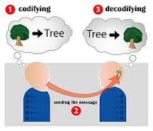
What is interpersonal communication?
It is communication that occurs between persons who have connection.
Communication occurs when you send or receive messages
It is an interdependent process which means:
what one person thinks and says impacts on what the other thinks and say.

Slide 23
It is always distorted by “noise “occurs within context and involves some opportunity for feed back.
Occurs in each other and of their connection with each other.

Slide 24
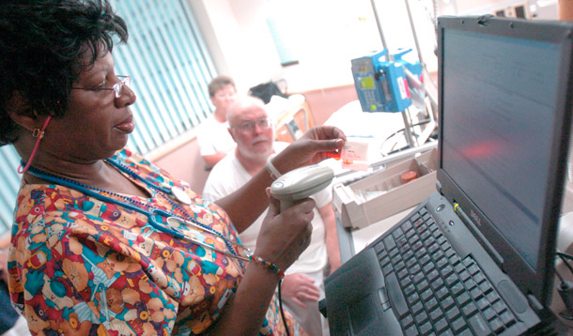
Electronic Communication
Advantages
  Fast
  Efficient
  Legible
  Improves communication, continuity of care
Disadvantages
  Client confidentiality risk
  Socioeconomics

Slide 25
Do not use e-mail
  Urgent information
    Jeopardy to client’s health
  Highly confidential information
  Abnormal lab data
Other guidelines
  Agency-specific standards and guidelines
  Part of medical record
  Consent, identify as confidential

Slide 26
Effective Written Communication
Does not convey nonverbal cues
Same as verbal AND
Appropriate language and terminology
Correct grammar, spelling, punctuation
Logical organization
Appropriate use and citation of resources

Slide 27
The process of interpersonal communication
Sources –receiver (at least two person exchange the communication .
Messages (express thoughts, feelings, verbal or non verbal communication.
Every message has an effect and outcome .
Messages overload, feedback and feed forward

Slide 28
3. Channel: the medium through which messages signals pass. The channels works like a bridge connecting source and receiver.
4. Noise
5. Context (the environment that influences the form and content of communication).

Slide 29
Noise
It is any thing that interferes with your receiving a message that some one is sending or with their receiving your message.
Noise may be:
1.Physical ( loud talking ,illegible hand writing ,garbage on your computer screen
2.Physiological ( hearing or visual impairment )
3.Articulation disorders . Language speech disorder e.g. Cerebral palsy(CP), down syndrome , and Autism
4. Psychological (preconceived ideas ,wondering thoughts, biases).
5.Semantic (misunderstood meanings ).

Slide 30
Context
It is an environment that influence the form and the content of communication ( natural e.g. street noise, or strict e.g funeral, quite place) .
Context of communication has at least four dimensions.
1.Physical dimension: effect of physical when
communicate, e.g. the room ,workplace readiness.
2.Cultural dimension: consist of rules ,norms, beliefs
and attitudes of the people communicating that are
passed from one generation to other (More details to come later)

Slide 31
3. Social-psychological dimension: include the status relationships among the participant e.g. who is the employer and employee, the formality or informality, the cooperativeness or the competitiveness of the interaction
4. Temporal or time dimension: It has to do with where a particular message fits into a sequence of communication events
e.g. if you tell a joke about sickness immediately after your friend tells you she is sick, the joke will be perceived differently from the same joke told as a series of similar jokes to your friends in the locker room of the gym

Slide 32
Interpersonal competence
The ability to communication effectively by mastering the skills of listening, critical thinking ,ethical foundation and power .
The more words you know the more of ways you will have to express your self.
The process goes like this:
1.Knowledge of interpersonal communication leads to greater interpersonal ability.
2.Leads to greater number of choices or option for interaction
3.Leads to greater interpersonal effectiveness

Slide 33
Six themes of competence
1. Interpersonal skills- large and ready collection of
interpersonal skills that can be used as the situation
warrants.
2. Power-skills for increasing and maintaining power
and influence as will as the situation warrant.
3. Listening– effectiveness of listening skills upon the
situation. You cant be a competent communicator if you are a poor listener

Slide 34
4. Critical thinking- skills for thinking logically, intelligently and reasonable about communication & message appropriateness. It is the way of examining information and reaching a judgment and decision
5. Cultural sensitivity- or cultural competency ….skills for communication effectively in intercultural situation
Ethical foundation- skills for communicating effectively with sound ethical principles.
- Communicate with people in a unique valuable way

Slide 35
Principles of interpersonal communication
another way to define communication is to consider its major principles
1. Package of signals involve verbal messages & gestures or together/
2. Involves content and relationships messages (supervisor & trainee).
Note :conflict may arise because of misunderstand relationship message.
3. Process of adjustment: This means sharing the same communication .e.g. learning the other person signals.

Slide 36
Principles of interpersonal communication Cont.
Communication accommodation mean speakers will adjust to the style of their listeners so as to gain social approval and greater communication efficiency
e.g. parents and children have different vocabularies and different meanings
Ambiguous: Having more than one meaning.
Ambiguity results when we use words that can be interpreted differently
Examples person might interpreted time terms differently example: Soon, right away, late.

Slide 37
5- Purposeful: Interpersonal communication serves various purposes:
General purposes (inner circle)
Motivation (middle circle)
Results (outer circle)

Slide 38
General purposes (inner circle)
Helps you to learn, and better understand the external world.
Helps you relate, maintain close relationships, and find connections
Helps you to influence the attitudes and behaviors of the others.
Helps you to play and help other

Slide 39
Characteristics of interpersonal communication
1. Inevitable ( unavoidable)
2. Irreversible
3. Unrepeatable

Slide 40
1. Inevitable ( unavoidable)
Sometimes you are communicating even though you may not think you are or you may not even want to.
Example student sitting in the back of the room with expressionless face, the message he or she is sending or sharing involves lack of interest anxiety

Slide 41
2. Irreversible
Although you may try to qualify deny or somehow reduce the effect of your message you cant withdraw message you have conveyed.
Be carful not to say things you may wish to withdraw later

Slide 42
3. Unrepeatable
Simply because everyone and everything are constantly changing.
As a result you never can recapture the exact same situation, frame of mind or relationship dynamics that defined a previous interpersonal act.

Slide 43
Culture and interpersonal communication
  Culture: consist of the beliefs, ways of behaving that transmitted through communication and learning rather than through genes.

Slide 44
Gender: is considered a cultural variable at least in a part because culture teach boys and girls different attitude, beliefs, values and way of communication and relating to one another

Slide 45
The importance of culture
People become more sensitive to cultural differences.
They moved from “Cultural assimilation
(People should leave the native culture behind and adapt to their new culture) to a view that values cultural diversity (People should retain their native cultural ways).

Slide 46
The aim of cultural perspective
A cultural emphasis helps to distinguish what is universal (true for all people) from what in relative (true for people in one culture and not true for people in another culture).
communication with different cultures is knowing the cultural principles and ability to communicate, and adjust well based on cultural sensitivity and differences

Slide 47
The aim of cultural perspective- cont.
Cultural perspectives influence:
What you say to yourself and how you talk to others in everyday conversation.
How you interact in a group.
Topics you talk about
Strategies you use in communicating information or in persuasion.

Slide 48
Theories of communication
The linear view
Interactional view
Transactional

Slide 49
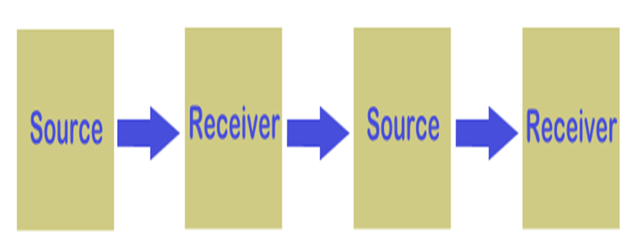
1. The linear view of human communication
Some early theories viewed communication as linear which means the speaker spoke and the listener listened.
After the speaker finished speaking, the listener would speak.
Indicting one way communication-Active speaker and passive listener.
Speaking and listening were seen as taking place at different times when you spoke you didn’t listen and when you listen you didn’t speak

Slide 50
2. Interactional view- interactive model
In this view the speaker and the listener were seen as exchanging turns at speaking and listening
Listener give feedback
Communicators create and interpret messages

Slide 51
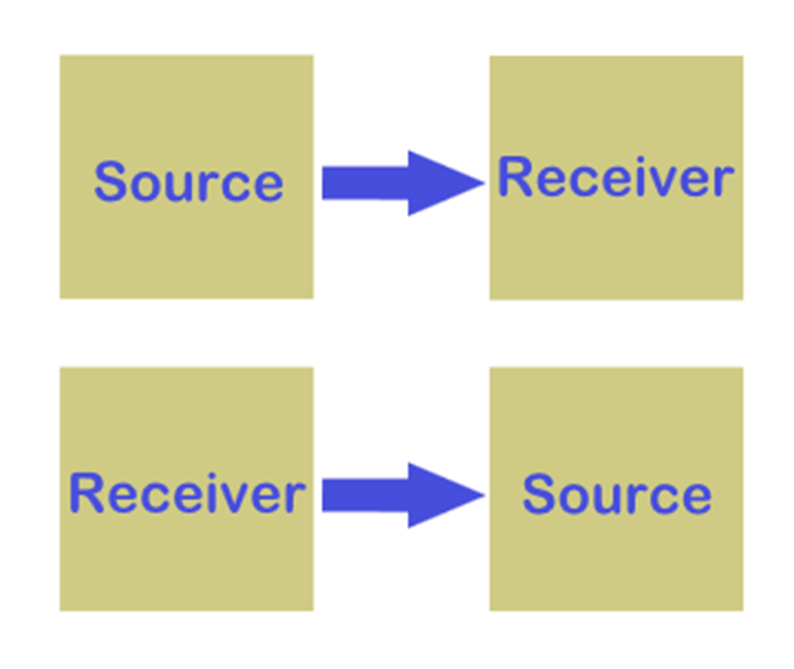
Interactional view

Slide 52
3. Transactional view
At the same time you send a message you receive a message from your own message and from the reaction of other people .
At the same time that you are listening you are also sending messages.
Elements of communication are seen as interdependent never independent

Slide 53
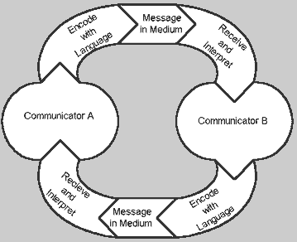
Transactional view

Slide 54
Transactional view- Cont.
Communicators play different roles during the process
Communication vary over time (example change in the audience will change what you say and how you say it)
When interpersonal communication takes place face to face conversation will proceed.

Slide 55
Transactional view- Cont.
Face to face conversation:
This type of interaction that probably comes to mind
when you think of conversation.
However there are other types of conversations such as:
E-mail–usually type your letter in an e-mail program and send it from your computer to your server which relays (transmit) your message to person you are addressing
Chat groups: these groups enable members to conserve in real time in discussion groups called channels.

